Slide 1
Prevention Updates August 2021 Quarterly Meeting
DAODAS Prevention Team

Slide 2
What we will cover:
General Updates and Announcements
Upcoming Training Events/Conferences
Fentanyl Test Strip Program and OEND
New funding opportunities
CTC/CORE Survey Data Collection
FY22 Funding and Compliance Contract
FY22 Primary Prevention Services Manual
FY 22 Data Reporting

Slide 3
General Updates and Announcements

Slide 4
Updates from MADD
https://www.madd.org/south-carolina/
Upstate:September 25 @ 8:00 am - 11:00 am
Low Country:November 6 @ 8:00 am - 11:00 am

Slide 5
The 2020 Prevention Outcomes Report, Infographic, and Evaluation brief are on the South Carolina Prevention Evaluation Resources webpage. As with other files on the site, the items can be found using search box and category selection.
The easiest method is using the Prevention Quarterly Meeting Material category and then the August 5, 2021 subcategory.
https://ncweb.pire.org/scdocuments/
Prevention Quarterly Meeting Material
August 5, 2021 (upcoming)
2020 Outcomes Report Infographics
2020 Prevention Outcomes Annual Report Brief
2020 Prevention Outcomes Annual Report

Slide 6
PREP Reminders
Some county agencies are implementing PREP via ZOOM, Adobe Connect, or some other online platform.
While face-to-face delivery of the program is still the preferred method, it is understandable that during the public health crisis, this program will need to be delivered via technology. Fidelity of the program and delivery of all material continues to be of utmost importance. The virtual platform that you choose should allow you to:
Utilize all program materials- power point, handouts and videos
Have a discussion with participants and answer questions
Your agency may need to mail the participant booklet ahead of the class (or if your offices are still open, have participants come by to pick-up materials prior to the class). Using a platform that allows you to see your participants is best-this will allow you to interact with (see when they have a question, looking confused, etc.).

Slide 7
PREP Reminders
Test Link: https://www.classroomclipboard.com/830067/Test/C3C50C36-48CC-4FE8-9343-B1A289F34409
The test can be taken online using link above and code (FEFAHFF). The participant has 30 minutes to complete the test. The test is saved in the DAODAS account.
At the conclusion of the course, please send the following information for us to email you the scores and test results back:
first and last name of the participant (we need to know the exact name they register with to take the test) and the date of the training.
Email that information to: DAODAS - STEP Program email: daodas.stepprogram@daodas.sc.gov
All paperwork will also need to be submitted to DAODAS in a timely manner for certification cards to be mailed out.
Please ensure paperwork is legible.

Slide 8
SYNAR Coverage Study
The DAODAS prevention team concluded the Synar Coverage Study on July 16, 2021. The DAODAS prevention team identified 151 tobacco retail outlets and matched 136 outlets to the Synar Study list frame, which equates to a coverage rate of 90.07%.
The findings of the 2021 Synar Coverage Study indicate that the SC Synar list frame’s accuracy increased by 4% since the 2018 Synar Coverage Study.
Some of the strengths of this study the DAODAS prevention team consistently identified tobacco retailers, canvassed outlet address, and mapped out the most efficient routes. It is worth noting that Coverage Study did have its limitations.
DAODAS’s prevention team’s methods of Synar Study list frame cleaning, Synar Tobacco Enforcement Partnerships (STEP) program, and local implementation of the annual Synar Study appear to adequately cover the list of tobacco retailers across SC. While SC’s Synar List frame’s coverage has increased, more work needs to be done to identify outlets that have opened and closed.

Slide 9
Upcoming Events:
Overdose Prevention Day- August 31st
* If you are planning a NARCAN/DETERRA Distribution event, please email us the dates/times/locations and social media links so we can promote all events occurring Statewide on or near this date
September- Recovery Month- Statewide event on September 18th
SC State Fair- October 13-24, 2021
*A memo will be forthcoming seeking volunteers to help staff the booth
DEA Take Back- October 23, 2021 10 am- 2pm

Slide 10
Upcoming Training Events/Conferences

Slide 11
******August 20, 2021*****
Please register for South Carolina - Youth Transition to School / Effects of the Pandemic - Drug Trends! - 1.5 hours on Aug 20, 2021 1:30 PM EDT at:
https://attendee.gotowebinar.com/register/6979793686039663888
After registering, you will receive a confirmation email containing information about joining the webinar.

Slide 12
SCADA Virtual Workshops
The SCADA is pleased to offer a series of virtual workshops for attendees to continue their professional development. These workshops are being offered at no cost; however, registration is required. Please view the workshops below and register promptly.
Please check back often as additional workshops are being confirmed.
https://www.scalcoholanddrugacademy.org/scada-virtual-workshops

Slide 13
Join us for the 34th Annual National Prevention Network Conference
Resilience in Prevention: Opportunities to Adapt and Build for a Stronger Tomorrow
August 24 - 26, 2021
REGISTRATION: https://npnconference.org/
Opens in early June
Early Bird Registration (on or before June 30): $300
Regular Registration (after June 30): $350

Slide 14
The 2021 Annual Conference, will be held November 15-17 in Montgomery, Alabama at the Renaissance Montgomery Hotel & Spa at the Convention Center, in collaboration with the Alabama Law Enforcement Agency (ALEA) State Bureau of Investigation. Conference registration and hotel accommodations are now open!
https://nllea.org/Event/Registration?id=14

Slide 15
January 31-February 3, 2022 | Gaylord National (National Harbor, MD)
CADCA’s National Leadership Forum is a four-day conference packed with multiple adult and youth-oriented opportunities to learn the latest strategies to fight substance misuse and hear from nationally-known experts and policymakers with a full day dedicated to Capitol Hill events. The Forum is held in the Washington, DC area every year, normally the first week of February and brings together more than 2,700 participants representing community anti-drug coalitions, government leaders, youth, addiction treatment professionals, researchers, educators, law enforcement professionals, youth and faith-based leaders.
https://www.cadca.org/events

Slide 16
https://lifesaversconference.org/

Slide 17
April 18-21, 2022
Atlanta, GA
https://www.rx-summit.com/

Slide 18
Alcohol Policy 19: Building a Framework for Change
Alcohol Policy 19/AP19 Conference
Apr 27, 2022, 2:00 PM
Renaissance Arlington Capital View Hotel
Register Now
The 19th in a series of conferences on preventing and reducing alcohol-related problems using public policy strategies.
​
The alcohol policy conferences are a series that, from its outset in 1981, has been a forum for researchers, community practitioners, and public officials to meet and exchange findings, explore evidence-based solutions, and consider adoption of policies aimed at minimizing risks associated with alcohol use. The conferences have been organized by governmental, non-governmental and private organizations over the years.

Slide 19
Fentanyl Test Strip Program and OEND

Slide 20
The New Fentanyl Test Strip Distribution Program

Slide 21
Below are the key messages that staff who distribute Narcan should emphasize to recipients:
Test strips are used for harm reduction use only. A negative test result does not mean a sample is safe. All street drug use is inherently risky.
Read over the instructions on use before you begin to test because there are different steps to test different drugs.
It is best to test every bit you intend to consume! Fentanyl is never mixed evenly. Powder from one side of baggie (or one edge of pressed tablet), may contain no fentanyl at all, yet powder from the other side may contain a fatal dose!
Know how to correctly interpret/read the test results! (One Line =Fentanyl; Two Lines=No Fentanyl; No lines =invalid test)
It is more difficult to test Methamphetamines.
To avoid false positives, meth has to be diluted using more water. Don’t test shards or even pieces of shards in small amounts of water.

Slide 22
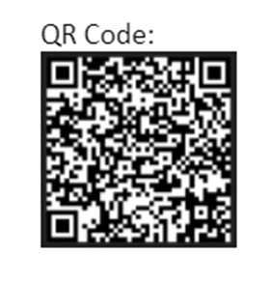
The Survey Tool
Purpose of the survey:
To enable DAODAS staff to conduct periodic analyses of the impact the Fentanyl test strip distribution program has on recipient's perception of risk and their subsequent behavior modification/risk reduction.
The survey will also identify within which counties respondents are finding fentanyl.
Anonymous/voluntary:
Although voluntary, staff are asked to explain the importance of the survey to recipients. Staff should point out the QR code and link provided on the written literature and ask the recipient to take the survey after they use the strips or when they come back in to get more FTS (by using the tablet to take survey on-site).
Survey link: https://www.surveymonkey.com/r/5FN59MZ
QR Code:

Slide 23
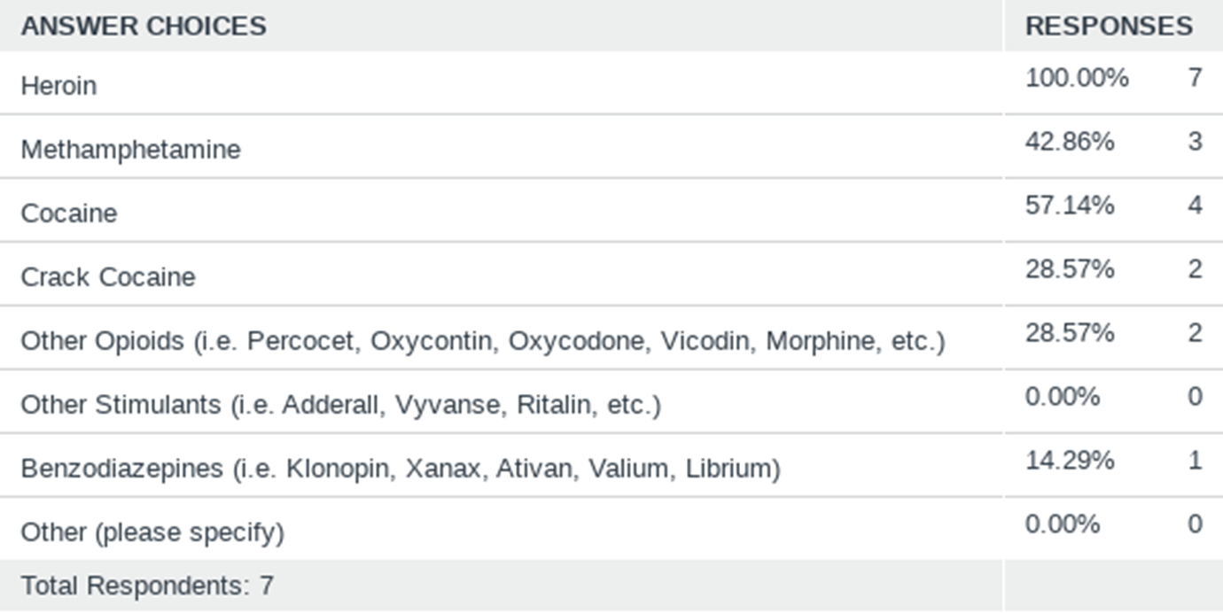
Q1: What kind of drugs did you test for fentanyl? (Check all that apply.)

Slide 24
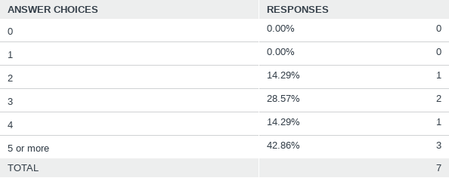
Q3: How many test strips were positive for fentanyl? (Please select from the drop down menu.)

Slide 25
Narcan Survey Tool
DAODAS is also rolling out a new anonymous Narcan survey tool that can be accessed similar to the FTS survey. Our goal is to better track those Narcan administrations that are being conducted by lay persons.
We are shipping out labels that can be placed on the existing Narcan written materials or actual Narcan boxes.
We can share those results in the near future.

Slide 26
Narcan Use Survey-plan to roll out this month! Business Card (front)

Slide 27
Narcan Use Anonymous Survey for Community Distributors (Business Card Back)

Slide 28
New funding opportunities

Slide 29
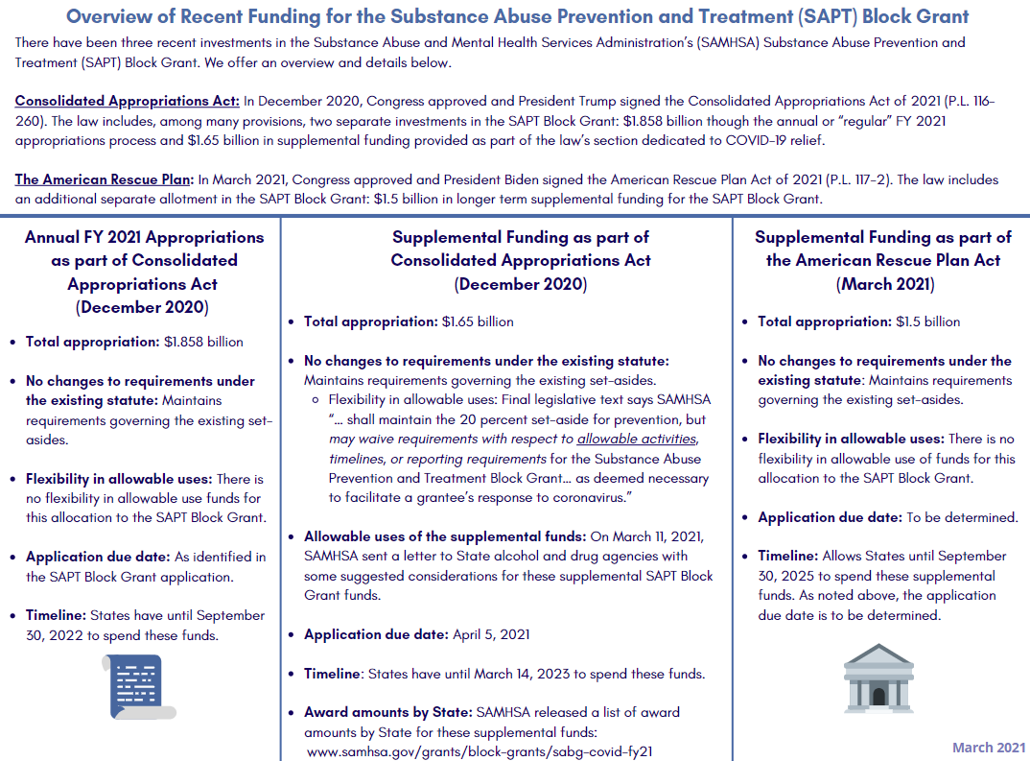
Information Reference: NASADAD

Slide 30
SAMHSA Guidance:
Enhance the primary prevention infrastructure within your state and communities using the Strategic Prevention Framework planning model and implementing evidence-based practices, the six CSAP prevention strategies with an emphasis on environmental approaches
Consider incorporating strategies around adverse childhood experiences to improve substance misuse outcomes among all populations, but especially young adults 18-25 and those over 26 years of age; preventing and reducing marijuana use by youth below the state’s legal age of use; and mitigating the impact of increased alcohol access by youth as identified during the COVID-19 pandemic. It is important to identify and address disparities and describe how you are incorporating equitable approaches.

Slide 31
DAODAS Response/Plan for primary prevention:
COVID-19 ( at least 20% of total award): $4,446,172.00 (SC allocated a little over 21%)
ARPA Primary Prevention ( at least 20% of total award): $3,839,876.00 (SC allocated 20%)
Total Primary Prevention from two awards: $8,286,048.00
South Carolina will use the resources provided from the ARPA and COVID-19 to enhance the state’s prevention infrastructure by addressing needs related to data collection, program/strategy implementation at the local level for high-risk populations/health disparate populations and work to improve substance misuse outcomes among youth, young adults, and older adults throughout the state utilizing the SPF. South Carolina will also place an emphasis on addressing the impacts of COVID-19 pandemic on alcohol use and associated risk factors/consequences of alcohol use.

Slide 32
Evidence-Based Prevention Programs, Policies, and Practices Implementation Grants for Communities.
Total Investment: $4,860,000.00 -COVID-$2,580,000.00 and ARPA:$2,280,000.00 (58.65%)
$1,620,000 per year x 3 years= $4,860,000.00
Through a competitive process,18 counties will be selected to receive up to $90,000 to implement primary prevention evidence-based programs and strategies to address local needs based on the utilization of the SPF model. Using local data, communities will identify special populations to target, such as families, women of childbearing age, older adults, military families, LGBTQ+ individuals, underserved ethnic groups, etc. with an emphasis on health equity and ACEs data to identify population, problem behaviors, and selection of programs/strategies to implement and achieve outcomes over a three-year period. Sustainability will be a focus as well as building capacity through stable funding for staffing and program implementation.
https://www.daodas.sc.gov/

Slide 33
Evidence-Based Prevention Programs, Policies, and Practices Implementation Grants for South Carolina Colleges and Universities.
Total Investment: $750,000.00 -COVID-$250,000.00 and ARPA:$500,000.00 (9.05%)
$250,000.00 per year x 3 years= $750,000.00
Through a competitive process, 5 colleges/universities will be selected to receive up to $50,000 to implement evidence-based primary prevention programs and strategies to address local needs based on the utilization of the SPF model over a three-year period.
https://www.daodas.sc.gov/

Slide 34
Education and Awareness Campaign to Address Alcohol, Tobacco, and Marijuana Use in South Carolina Throughout the COVID-19 Pandemic -will impact all counties
Total Investment: $1,221,048.00 -COVID-$236,172.00 and ARPA:$984,876.00 (14.74%)
**Portion of this will go out to field for local placement of materials-not able to give specific details at this time. Once the cost to develop materials is determined, DAODAS will provide each agency funding for local dissemination efforts. Will solidify this plan in upcoming months.

Slide 35
Education and Awareness Campaign to Address Alcohol, Tobacco, and Marijuana Use in South Carolina Throughout the COVID-19 Pandemic -will impact all counties
Ensuring the availability of current, culturally appropriate, and age-appropriate information can play a role in counterbalancing the normative culture of substance use/misuse and help people make an educated, informed decision. Funds will be utilized to develop culturally appropriate and age-appropriate educational materials that can be utilized at the local county/coalition level to educate youth, young adults, parents, caregivers, and community members on substance use/misuse and abuse of alcohol, tobacco, and marijuana in South Carolina. Examples of materials that will be developed include: social media toolkits, educational presentations, billboards, handouts, etc. The materials will include South Carolina-specific information such as data/statistics, laws and policies/practices, in addition to factual information from federal sources such as SAMHSA, NIDA, CDC, NIAAA, DEA, FDA, etc.

Slide 36
Addressing Alcohol/Alcohol Use during pandemic
Total Investment: $1,280,000.00 all from COVID-19 (15.45%)- This will be available to all 46 counties through the 16 judicial circuits.
Additional funding from the COVID-19 supplement will allow the AETs to build on their current strategic plans and provide additional prevention strategies (across the 6 CSAP strategy areas) to address the rise in alcohol use during the pandemic in any age categories based on locally identified needs. This funding does not have to be specific to underage youth (can be if that is what local need determines). This funding can be to address alcohol use/consequences of use, etc. among any identified population through local data (young adults, middle-age adults, older adults, general population, etc).
Award all circuits $62,500 for year (total of 1,000,000.00). October 1- September 29, 2022. The remaining $280,000.00 would be allocated and spent on a winter "out of their hands" type campaign to target high -risk time of holidays (Thanksgiving, New Year’s, Christmas/Winter holidays, etc) material development and reproduction of materials. Ideas will be discussed with AET Coordinators and Prevention Directors.

Slide 37
Addressing Alcohol/Alcohol Use during pandemic
Funding will be allocated for addressing Increased Alcohol Use During the Pandemic (All populations-based on local data can address underage, young adult, older adults, binge drinking, impaired driving, etc.) through implementation of evidence-based environmental and educational strategies, information dissemination, alternative activities and problem identification/referral strategies.
Will have circuits provide a plan/budget-not a RFP process.
More information will be forthcoming before the end of August.

Slide 38
From new State Opioid Response Grant (SOR):
The South Carolina Department of Alcohol and Other Drug Abuse Services (DAODAS) State Opioid Response (SOR) Grant will provide up to $900,000.00 to fund approximately 18 single-year primary prevention sub-awards to organizations that serve South Carolina communities. The purpose of the sub-awards is to support implementation of evidence-based environmental and educational primary prevention strategies in an effort to prevent opioid and stimulant misuse, and to reduce the consequences of opioid and stimulant misuse in South Carolina.
Strategies may be implemented for the general population, or may be implemented for targeted populations. The planned sub-award period is October 1, 2021, to August 31, 2022. The available funding level per award is up to $50,000.00.
https://www.daodas.sc.gov/

Slide 39
CTC/CORE Survey Data Collection

Slide 40
Needs Assessment- CTC/CORE- can potentially impact all counties
Total investment: $175,000.00 ($100,000.00 from COVID and $75,000.00 from ARPA)- 2.11%
Our state places an emphasis on implementing the Strategic Prevention Framework (SPF) model. Needs assessments to identify local prevention needs are a priority, and resources are required to continue collecting survey data at the county level. Funding will be used to conduct the Communities That Care (CTC) survey for middle and high school youth in the spring of 2022 and in the spring of 2024. Funding will also be allocated for CORE survey data collection during the 2021-2022 school year from the COVID-19 supplement and in the 2022-2023 and 2023-2024 school years from ARPA.
Contact Dr. Sazid Kahn for more information: skahn@daodas.sc.gov
Guidance and Information will be coming out soon for CTC recruitment

Slide 41
FY22 Funding and Compliance Contract

Slide 42
ARTICLE II - COMPLIANCE
Accessibility of Services
Subgrantee shall accommodate the prevention, intervention, treatment, and recovery services needs of the Subgrantee’s catchment area and ensure that services are accessible to all citizens, by and through the implementation of extended hours or flexible schedules. If Subgrantee provides Withdrawal Management (Detoxification) and/or Residential services, Subgrantee must ensure that these services are continuously accessible 24 hours a day, seven days a week, and 365 days a year. Additionally, Subgrantee shall make every effort to admit prospective patients when beds are available and where the prospective patients present for services and are appropriate for admission.

Slide 43
Mandated Standards (45 CFR § 96.136)
Accreditations – Subgrantee shall obtain and maintain national accreditations by either The Joint Commission or CARF International in the specific program areas that are covered by this Contract. Subgrantee shall also maintain accreditations as required by DAODAS’ Treatment Programs Manual, as revised from time to time, and as required by DAODAS’ Primary Prevention Services Manual, as revised from time to time. Subgrantee must send copies of all required accreditation reports to DAODAS as a deliverable within thirty (30) days after each accreditation report is received by Subgrantee
DAODAS’ Primary Prevention Services Manual – Subgrantee shall consult with, and adhere to, DAODAS’ Primary Prevention Services Manual, as revised from time to time, for Prevention standards and requirements, some of which are included in Article IV, Subsections 2, 3, and 4, of this Contract.

Slide 44
Compliance Reviews
In accordance with 45 C.F.R. §96.136, DAODAS will perform Compliance Reviews of some or all of Subgrantee’s programmatic/financial documentation to ensure compliance with Subgrantee monitoring guidelines as published in 2CFR 200 – Uniform Guidance, SCDHHS Rehabilitative Behavioral Health Services (RBHS) Provider Manual, CARF, ASAM, and/or any other standards that DAODAS may deem appropriate. Compliance Reviews may include but are not limited to compliance, finance, clinical quality assurance, and prevention activities.

Slide 45
Quality Assurance and Mandatory Training
Subgrantee shall maintain and use a current Quality Assurance plan for Subgrantee’s continuum of services (including prevention services) addressing effectiveness (i.e., outcomes), efficiency, and patient satisfaction.
Subgrantee shall conduct internal Quality Assurance activities in a manner consistent with the most current accreditation standards manual of either The Joint Commission or CARF International.
Subgrantee shall ensure that all staff complete mandatory trainings offered by DAODAS that are stipulated by funding and compliance contracts as applicable to their job functions. Documentation of completed trainings shall be retained in the employee’s privileging file and shall be available for review during DAODAS’ Compliance Reviews.

Slide 46
Staff
Subgrantee shall secure all staff required in performing the services under the terms of this Contract. All of the services specified in this Contract and all personnel engaged in the work shall be fully qualified and authorized under state law to perform such services.
Subgrantee shall further have in existence personnel standards and a personnel compensation and classification system.
Subgrantee shall make reasonable efforts to ensure that employees working in any program component funded wholly or in part by SABG funds be afforded opportunities for continuing education per 45 CFR § 96.132 (b). These opportunities should be designed to meet the staff certification and licensing requirements to provide services under any grant. Records of such continuing education shall be maintained by Subgrantee.
In the event that Subgrantee discontinues a program or is not able to provide services for a specific program, Subgrantee must notify DAODAS within five (5) business days.
All personnel providing services funded by DAODAS shall be privileged by Subgrantee to provide each service and shall meet the applicable standards enumerated in this contract. Privileging documentation shall be maintained in Subgrantee’s privileging files.

Slide 47
State and Federal Funding Requirements
Notification of Federal Funds Used to Supplement Program Operations – Subgrantee shall comply with P.L. 101-517 § 511, as amended, that requires the federal funding source be clearly identified on any brochure, flyer, poster, press release, public service announcement, or other form of information dissemination, events (i.e., planning, production, or presentation of conferences, workshops, or trainings), publications, or any other document describing projects or programs funded in whole or in part with federal funds. Funding provided by DAODAS will be identified by the funding source and CFDA number if applicable. Subgrantee agrees by signing this Contract that it will include, without modification, the clause titled “Notification of Federal Dollars Used to Supplement Program Operations” in all lower-tier covered transactions (i.e., transactions with its subgrantees and/or subcontractors) and in all solicitations for lower-tier covered transactions in accordance with 45 CFR Part 76.
Allowable Costs – Allowable costs incurred under any DAODAS-funded grant or contract shall be determined in accordance with the general principles and standards for selected cost items as set forth in the applicable OMB Circulars referenced under “Audit Standards” and “Applicable Laws and Regulations.”

Slide 48
Non-Subplantation of Existing Programs – Subgrantee agrees that funds made available by DAODAS will be used by Subgrantee to implement or increase the level of funding in the specified services only. Funds received through a DAODAS-funded grant shall not supplant any other federally funded projects.
Procurement Policy – Subgrantee shall have a board-approved written procurement policy in force. Subgrantee is encouraged to utilize qualified minority firms where cost and performance of major grant work will not conflict with funding or time schedules.
Equipment – Unless otherwise specified by DAODAS, equipment under this Contract is defined as an article of tangible property that has a useful life of more than one year and an acquisition cost of five thousand dollars ($5,000) or more. Single items priced $5,000 or more must have prior written approval of DAODAS for DAODAS-reimbursable class codes. Title to all equipment purchased with funds provided by DAODAS shall rest with Subgrantee as long as the equipment is used for the program for which it was purchased. When the equipment is no longer required for the program for which it was purchased, DAODAS shall be notified, and then instructions will be issued by DAODAS pertaining to the disposition of the property.
Travel – Subgrantee shall adhere to the travel policies and procedures of the State of South Carolina in all program areas that are funded partially or in full by DAODAS, except in instances where Subgrantee is operating under the policies and procedures of county government or when policies and procedures approved by the governing board of Subgrantee do not exceed the provisions of the State of South Carolina

Slide 49
Records Retention
Records with respect to all matters covered by funding through DAODAS shall be made available to DAODAS or its duly appointed representatives for audit inspection or monitoring. All pertinent information, including financial records, supporting documents, statistical records, and patient records, shall be retained for a minimum of three (3) years after the final expenditure report. However, if any litigation, claim, or audit is started before the expiration of the three-year period, then records must be retained for three years after the litigation, claim, or audit is resolved. Subgrantee shall adhere to DHEC regulations for storage of outpatient and residential patient records.

Slide 50
Monitoring, County Assistance Plans, and Managed Improvement Plans
DAODAS will monitor key performance indicators regarding Subgrantee’s obligations pursuant to the contract; Subgrantee’s compliance with the treatment and prevention manuals, as revised from time to time; and Subgrantee’s general organizational stability. When deemed necessary by DAODAS, it may direct Subgrantee to make certain improvements through the implementation of a County Assistance Plan (CAP). The CAP will be designed by DAODAS to assist Subgrantee in the early detection and resolution of problems related to performance and/or general organizational stability. If DAODAS determines that implementation of the CAP has failed to correct the identified problems, Subgrantee shall be placed under a Managed Improvement Plan (MIP) and will be expected to make progress in resolving the problems in order to remain eligible for funding or other financial support from DAODAS.

Slide 51
Reporting Systems and Deliverables
Subgrantee must collaborate to implement database, reporting system, and electronic health record changes required by DAODAS. DAODAS, in collaboration with Behavioral Health Services Association of South Carolina Inc., will give Subgrantee as much advance notice as possible for software and hardware changes.
All data must be submitted on time in accordance with defined schedules.
Subgrantee shall submit all deliverables by the due dates and in the appropriate format. Requests for extensions to deliverables must be submitted on form “Request for Deliverables Extension” to the appropriate DAODAS program manager for review.

Slide 52
ARTICLE IV - PREVENTION
Staff Requirements for Prevention Services
In each county, agencies shall provide staff dedicated to the provision of primary prevention services as it relates to funding provided through the Substance Abuse Prevention and Treatment Block Grant (SABG) in each county as delineated in Subsection 2 below (Primary Prevention/Education Program).
Minimum Qualifications – To provide or coordinate prevention services as an employee of a county alcohol and drug abuse authority, staff who were hired by a county authority after July 1, 2006, must hold a minimum of a bachelor’s degree from an accredited college or university, be certified or in the process of becoming certified, and be under active and ongoing prevention mentoring.
New Hires/Position Changes – Subgrantee must inform the DAODAS Manager of Prevention and Intervention Services in writing within five (5) days of a new position hire/change in SABG- or other DAODAS-funded prevention staff positions. Agencies should submit the following information: name, position, e-mail address, and telephone number. Changes and/or updates must also be made into the prevention database as soon as the change/hire takes effect.
Reference: FY22 DAODAS Funding and Compliance Contract – Page 19

Slide 53
Certification
Staff shall be certified by:
the South Carolina Association of Prevention Professionals and Advocates (SCAPPA) Certification Commission as a Certified Prevention Specialist (CPS); or
the SCAPPA Certification Commission as a Certified Senior Prevention Specialist (CSPS).
Certified prevention staff must have a written training plan, updated annually, pertinent to maintaining SCAPPA certification.
In Process – Staff may be privileged to provide prevention services while in the process of earning certification. The “in-process” person:
Must apply for certification by SCAPPA as a CPS or CSPS within six (6) months of hire. (Evidence of the employee’s application for SCAPPA certification must be placed in his/her privileging or personnel file.)
Must have a detailed written training plan to obtain certification within thirty-six (36) months of his or her application for certification, and must achieve certification by the end of this three (3)-year period. The certification timeframe does not restart if the employee leaves the agency and joins a different agency. The application is transferable to another agency where the person is employed during the 36-month time period. (A copy of the written plan, signed by the staff member and their manager, must be retained in their privileging or personnel file and updated on an annual basis.)
Must be under active and ongoing prevention supervision.
Must be engaged in an active and ongoing prevention supervision process. Supervision must be provided by an individual approved by SCAPPA. A written plan that addresses information on the supervision progress shall be placed in the employee’s privileging or personnel file. Both the staff member and their manager must sign this plan and update it on an annual basis. Documentation that SCAPPA has approved the prevention supervisor must be attached.
Reference: FY22 DAODAS Funding and Compliance Contract – Page 19

Slide 54
Primary Prevention/Education Program (PREV-CG), Class Code 8001
Subgrantee shall adhere to and maintain compliance with all DAODAS prevention requirements, including but not limited to any funding set-asides, reporting, expenditure, and training requirements. Subgrantee shall adhere to the DAODAS Primary Prevention Services Manual, as revised from time to time, as well as any specific instructional memoranda, in the execution of this provision.
Alcohol Enforcement Team (AET) / Class Code 8016
Subgrantee shall adhere to and maintain compliance with DAODAS’ prevention requirements that are associated with the Alcohol Enforcement Team (AET) program. Subgrantee shall adhere to the DAODAS Primary Prevention Services Manual, as revised from time to time, as well as any specific instructional memoranda, in the execution of this provision.
Prevention Reporting Requirements and Evaluations
Subgrantee shall adhere to and maintain compliance with DAODAS’ reporting and evaluation requirements. Subgrantee shall adhere to DAODAS’ Primary Prevention Services Manual, as revised from time to time, as well as any specific instructional memoranda, in the execution of this provision.
Reference: FY22 DAODAS Funding and Compliance Contract – Page 20

Slide 55
FY22 Primary Prevention Services Manual

Slide 56
Primary Prevention Services Manual Definitions, Quality Assurance, Standards, and Forms – FY22
Few Additions/Clarifications to manual based on feedback from field (April call). Additions/Clarifications are as follows:
Addition of National Accreditation information: A key element for ensuring that the highest- quality prevention services are provided to all South Carolina citizens, DAODAS funded organizations shall obtain and maintain national accreditation by either the Joint Commission or CARF International for their primary prevention programs that target children, youth/adolescents, and adults. It is recognized that prevention services can be provided in service programs as varied as those focused on or around primary prevention, diversion/intervention and employee assistance. Due to the Substance Abuse Prevention and Treatment Block Grant requirement of a 20% set-aside for primary prevention, it is anticipated that at a minimum DAODAS funded organizations receiving funding through the20% set-aside for primary prevention the corresponding program that is based solely on primary prevention principles and thus termed the organization’s primary prevention program would be accredited.

Slide 57
Primary Prevention Services Manual Definitions, Quality Assurance, Standards, and Forms – FY22
All prevention staff shall attend the Substance Abuse Prevention Specialist Training (SAPST) within two years of their hire date.
DAODAS requires reporting through the required web-based reporting system for all prevention strategies implemented by the AETs at the local, county, and circuit levels. It is the responsibility of the AET Coordinator to ensure all prevention strategies are reported for the circuit for each county through the DAODAS required reporting system. Data can be entered by law enforcement partners, prevention partners and/or the AET Coordinator in each county’s reporting system. The process for who is entering what at a local level should be discussed and documented at the beginning of the fiscal year. The AET Coordinator should have access to all of the data entry points for each county and should ensure that all data is entered in accurately by the 8th working day of the month for the previous month’s activities. Agencies are required to use the online reporting system for all prevention strategies implemented by the AETs in all counties throughout the circuit for the previous month.

Slide 58
Primary Prevention Services Manual Definitions, Quality Assurance, Standards, and Forms – FY22
The AET Coordinator shall collaborate with the prevention coordinator for each county authority served through the circuit to either obtain a log-in for the web-based reporting system to enter data directly or ensure that all data is provided to the local prevention coordinators for county data entry into the web-based system.
Correct percentage of time for the AET Coordinator shall be reflected in each county’s web-based reporting system, and the AET Coordinator shall report service hours to reflect that percentage each month in the web-based reporting system.
It is the responsibility of the AET Coordinator to work with each county authority’s prevention coordinator in their circuit on the development of outcome work plans for each county that reflect strategies around the target substance of alcohol. The AET Coordinator shall assist county authorities in documenting the coordinated outcome work plans in the web-based reporting system.

Slide 59
Primary Prevention Services Manual Definitions, Quality Assurance, Standards, and Forms – FY22
The organization utilizing the DAODAS Standard Survey who determines that this is the case is asked to send an email to prevention@daodas.sc.gov to notify DAODAS as quickly as possible so that a meeting can be facilitated with the state prevention evaluation contractor.
FY22 Prevention Work Plan Requirement Checklist has been updated
Prevention Staffing Capacity Plan FY22 has been updated
Addition of FY22 Prevention Specialist Training Plan Form

Slide 60
SAPT BG Primary Prevention Set Aside Formula
No major changes for FY22 (FY22 implementing final formula with no modifications)
Highlights:
A standard formula for the distribution of the SABG primary prevention set-aside funding and State funding allocated to prevention. The formula was adopted by DAODAS in July 2013 and went into effect with state Fiscal Year 2014 (FY14). The formula was updated in FY20.
The adopted allocation method was developed by DAODAS with input from BHSA to achieve a base funding amount for each county, along with a population-adjusted figure to ensure that prevention services are provided equitably across the state.
The state will provide SABG primary prevention set-aside dollars and State funds allocated to prevention solely based on the funding formula that can be replicated and articulated across all county authorities.

Slide 61
SAPT BG Primary Prevention Set Aside Formula
FY14 Formula
1. The “floor” was $40,000 for each county authority.
2. County authorities that serve more than one county receive a “bump” of $10,000 per county.
3. Population adjustments range from $4,856 to $158,039.
4. Additional funds – which will be used for performance bonuses in future years –were allocated proportionally in FY14 to minimize the impact to agencies that lost 10% or more of county prevention funding.
FY20 Formula
1. The “floor” (base) will be $60,000 for each county authority.
2. County authorities that serve more than one county receive an additional $15,000 per county.
3. Revised population-based estimates for July 1, 2018, were set by the U.S. Census Bureau on April 18, 2019. The percentages did not change from Fiscal Year 2013. These range from 0.42% to 13.98%. The funding range changed from $6,300 to $209,700 due to an increase in the funding allotted to this part of the funding formula and the population estimates. (https://www.census.gov/quickfacts/fact/table/US/PST045218) At a minimum, population adjustments will be revised every five years.

Slide 62
SAPT BG Primary Prevention Set Aside Formula
Central Tenets
Certain statewide or state-level commitments are funded “off the top.” This did not change from the previous formula. These include:
1. Alcohol Enforcement Teams, which are funded at $35,000, $40,000, or $50,000, based on the population of the judicial circuit (divided into three tiers); and
2. DAODAS prevention-related contracts, operations, provision of prevention materials statewide (such as PREP materials), and personnel.
In addition, state base prevention funding has been reallocated, and each county authority will receive $1,800 per county in base funding. (Slight increase from $1,500 per county from previous year-due to final adjustment of formula)
In future years, county authorities may request supply/material and training costs in their submitted County Plans, and DAODAS will consider one-time funding for these items if funds are available to allocate and spend from a previous SABG award. Funding requests related to personnel will not be considered unless new federal or state resources are made available to DAODAS. If there are increases to the federal SABG award in the future, DAODAS will make adjustments to allocated amounts based on the elements set forth in the funding formula.

Slide 63
FY 22 Data Reporting

Slide 64
FY 22 Reporting
DAODAS is working with State Procurement-final stages to issue a contract for selected vendor for new Grants Management System.
Contract amendments have been issued to Mosaix and PIRE to continue with current reporting systems for up to 6 months (end of calendar year).
Once contract is in place, timeline for development, training and implementation of GMS will be provided.
DAODAS has been working with the BHSA Prevention Committee to improve the data collection efforts to include discussion of service codes, definitions/guidance for field and use of current and future reporting system.
Additional instructions for FY22 set-up will be forthcoming. Updated guidance documents will also be forthcoming. Please keep track of services/time for month of July outside of system.
Service Code list will be updated next week.
System set-up and data entry for July and August will be due 8th working day of September.

Slide 65
FY 22 Reporting
Prevention data is due on the 8th working day of the month for the previous month’s services
Minimum standards for accuracy of monthly data entered into the IMPACT system are as follows:
accurate use of prevention service codes provided by DAODAS;
correct application of service codes and categories (direct vs. indirect, single vs. recurring services, service hours vs. administrative hours, etc.);
required monthly documentation of service hours for any organizational member or volunteer who is providing prevention services;
six-month benchmarks shall be entered for all process objectives no later than the eighth working day of January;
year-end benchmarks shall be entered for all process and outcome objectives no later than the eighth working day of July; and
agency shall appropriately document funding and report to ensure compliance.

Slide 66
Questions?

Slide 67
1801 Main Street, 4th Floor • Columbia, South Carolina 29201
telephone: 803-896-5555 • fax: 803-896-5558
www.daodas.sc.gov

